Slide 1
PythonDayFour -Logical Operation
PoHanWu
20190202

Slide 2
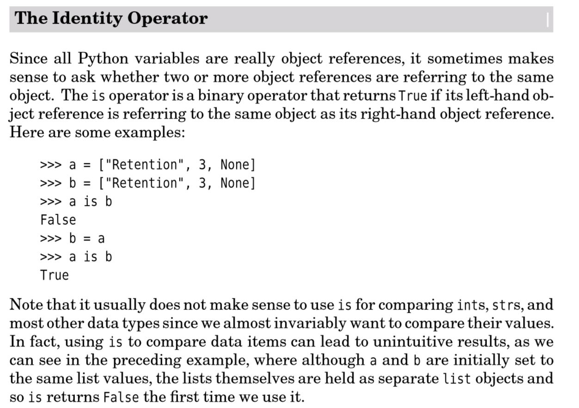
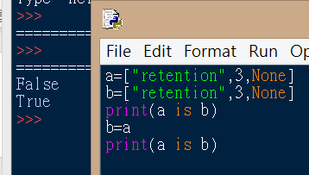
“is”

Slide 3
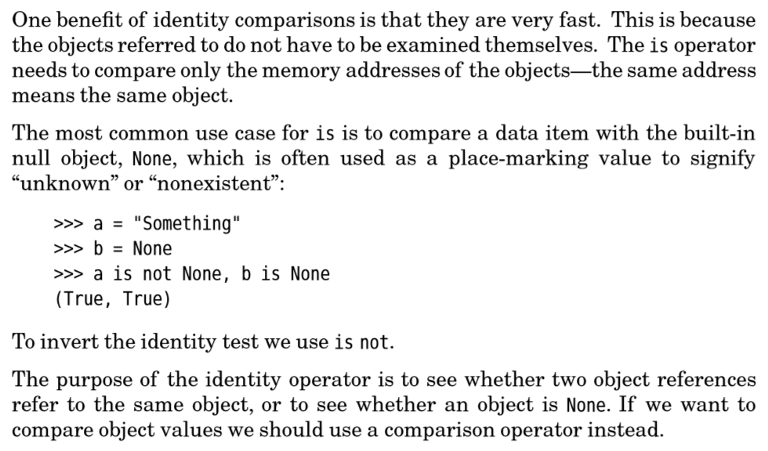

Use Operator “is ” check none

Slide 4
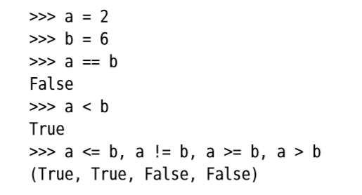
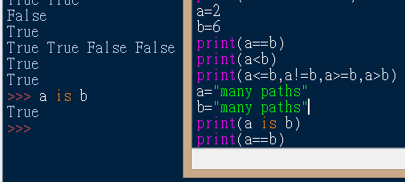
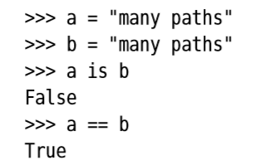

Comparison Operators

Slide 5


Chained comparison operators

Slide 6


Python traceback

Slide 7

tips

